Slide 1
The goal of log anomaly detection is to accurately distinguish between normal and anomalous logs. However, due to the highly imbalanced distribution of normal and anomalous logs in publicly available datasets (HDFS: 2.93%, Spirit: 15.29%, Thunderbird: 0.49%, BGL: 7.34%), many log anomaly detectors tend to report inflated metrics (F1 scores over 0.9). While these detectors perform well in identifying positive samples, they often struggle to effectively recognize negative samples. In Hoang's paper, "How Far Are We?", when advanced detectors are evaluated using fixed windows and session-based segmentation, many issues arise, primarily because the positive-to-negative sample ratio becomes more balanced under these conditions, increasing the detection difficulty.
This observation leads us to consider whether it's possible to design an anomaly detector that maintains robust generalization performance even when the positive-to-negative sample ratio is more balanced, as in session-based or fixed-length segmentation. To address this, we have developed an anomaly diagnosis mechanism that not only significantly improves detection accuracy in high-fault-rate scenarios but also automates the precise threshold search, eliminating the need for tedious manual tuning.
Specifically, we select a subset of log blocks from the training set and store them in a container. Then, we compare each log block under inspection with those in the container using cosine similarity. The top-k most similar log blocks are chosen, and a probability value is generated based on this comparison. Following this, we use an xLSTM model to calculate the reconstruction error. We then apply additive attention to combine the probability value and the reconstruction error, creating a threshold objective function. Finally, we search for the optimal threshold within this objective function and apply it to the test set. Experimental results have demonstrated the effectiveness of this method.

Slide 2
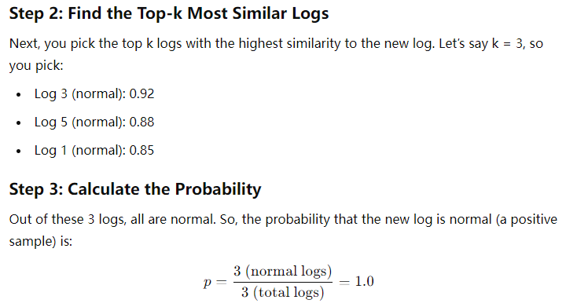
Imagine you have a training set with logs, and each log is either normal or abnormal. Now, you have a new log that you want to check for anomalies by comparing it to the logs in your training set.
Step 1: Calculate Cosine Similarity
First, you turn the new log and each log in the training set into vectors . Then, you calculate the cosine similarity between the new log and each log in the training set.
For example:
Log 1 (normal): 0.85
Log 2 (abnormal): 0.78
Log 3 (normal): 0.92
Log 4 (abnormal): 0.70
Log 5 (normal): 0.88
top-k

Slide 3
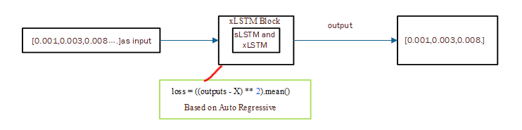
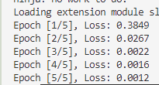
The basic model is already established, but how do we simulate the workflow? I drew inspiration from the AutoRegressive approach of diffusion models. We designed a model that uses reconstruction error based on time series, which captures the temporal dependencies within the data. Although this is not a typical AutoRegressive model, it considers the sequence's time dependency during reconstruction, so it can be seen as an indirect AutoRegressive method. This distinction is important to prevent any misunderstanding for readers.
Now, let me introduce the concept of reconstruction error. The essence of this approach is to design a model with the goal that when a sequence of data is input, the model’s output should closely match the input. If it does, this indicates that the model has learned the ability to capture the workflow of the logs.
Here’s the translation:
We aim to design a model that, as shown in the figure, can simulate the workflow. The loss function is defined as the mean squared error between the output and the input. If the loss function continues to decrease and converges, it indicates that the workflow can be successfully simulated. The results have proven that this approach is feasible.
Importantly, I will store the values of this loss function in a list, which will later provide input information for threshold selection, in a format like [0.0001, 0.1, 0, ...]. I will also normalize these values. Each element in the list represents the loss or the difficulty of reconstructing a log block’s workflow.

Slide 4
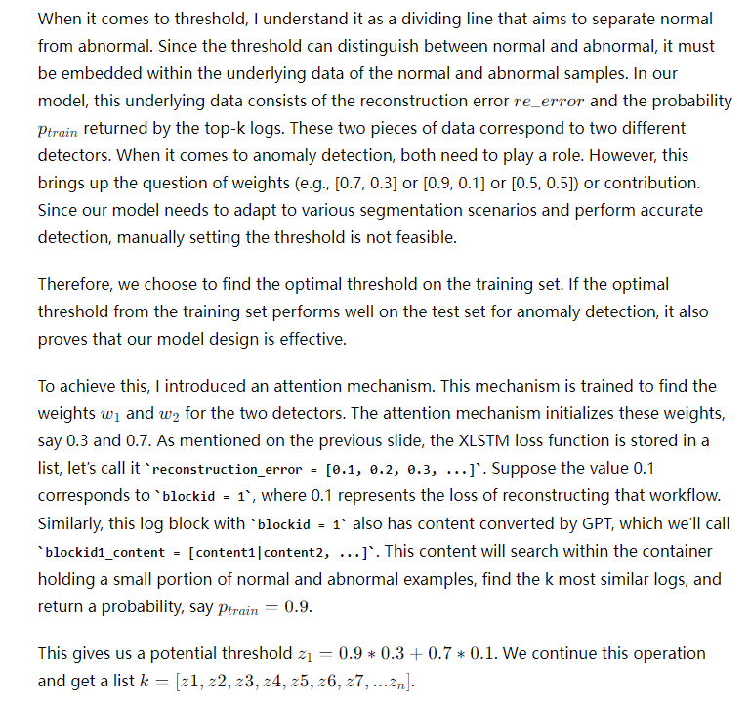

Slide 5
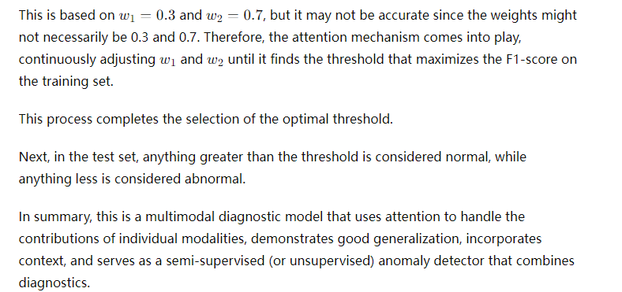

Slide 7
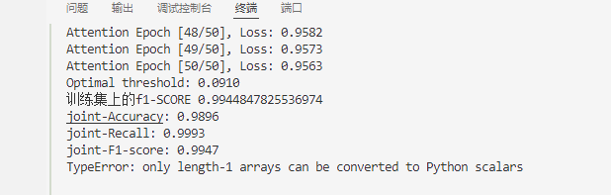
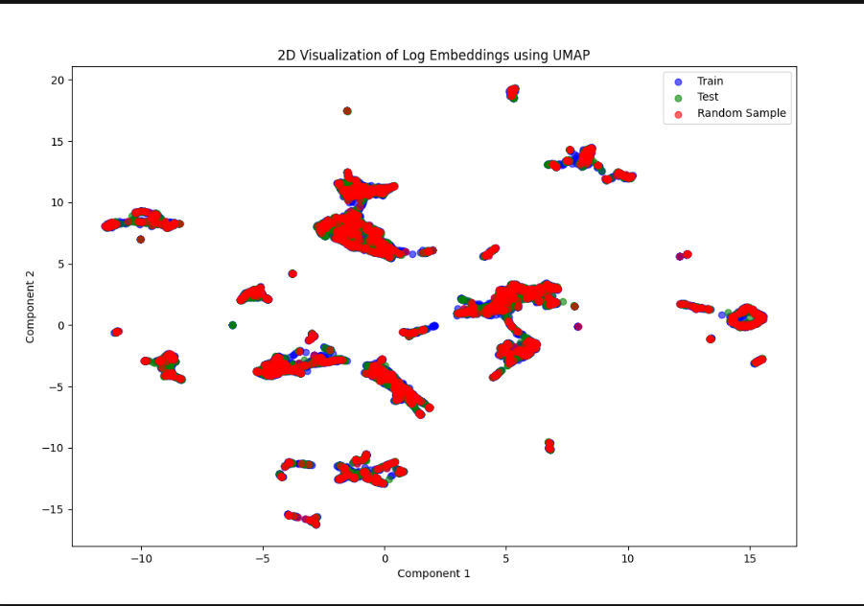
TEST
During the testing phase, we will use the maximum threshold obtained from the training set to determine whether a log is anomalous. If the loss value is greater than the threshold, the log is considered normal; if it is less than the threshold, it is considered anomalous.

Slide 8
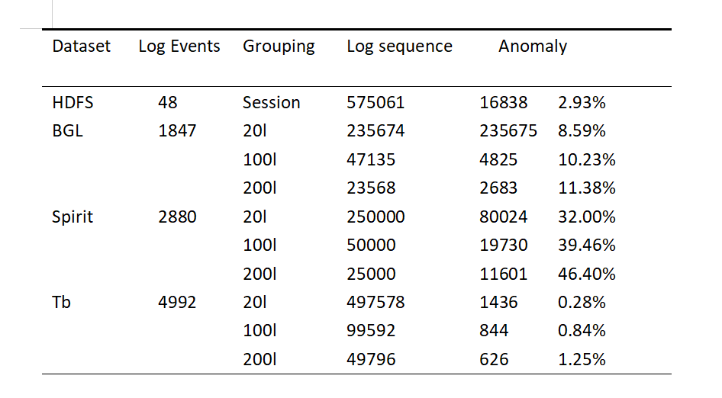
实验设置
To evaluate the studied models for log-based anomaly detection, we select four public datasets , namely HDFS, BGL, Thunderbird, and Spirit. The details of each dataset are as follows:

Slide 9
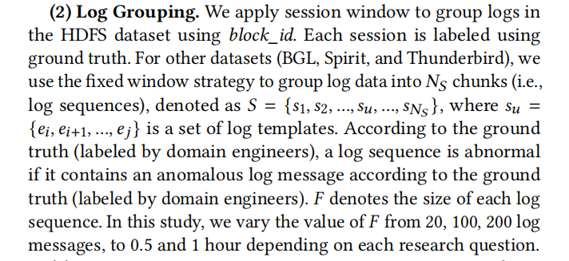
When splitting the data, we strictly followed the above-mentioned splitting rules as hoang.

Slide 10
MEtrices
Imagine you have a machine that sorts apples into two categories: "Good" apples and "Bad" apples. You have 100 apples, and you already know that 80 of them are good and 20 are bad. After running the apples through the machine, you check how well it did.
Accuracy
Accuracy is the simplest measure. It tells you how many apples the machine sorted correctly, both good and bad, out of the total number of apples.
Accuracy is good when your data is balanced (e.g., an equal number of good and bad apples), but it might be misleading if you have many more of one type than the other.
Recall (Sensitivity)
Recall focuses on how well the machine identifies all the good apples (or all the bad apples, depending on what you care about).
Recall is important when you want to ensure you catch as many good apples as possible.
Precision
Precision is about how many of the apples the machine says are "Good" actually are good.
Precision is crucial when you want to minimize the number of bad apples being mistakenly labeled as good.

Slide 11
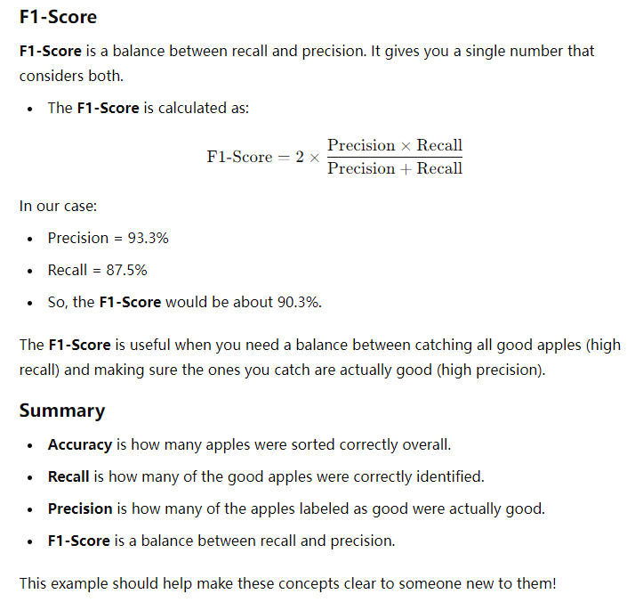

Slide 12
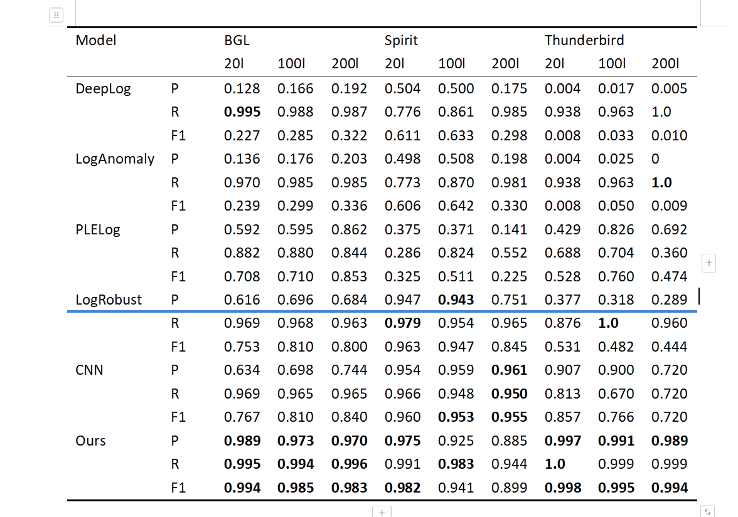

Slide 13
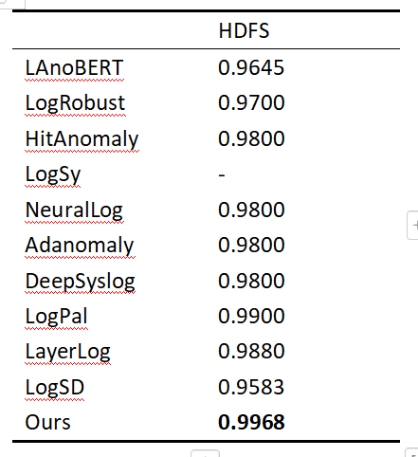
To ensure fairness, the HDFS dataset, which lacks time stamps, cannot be segmented based on fixed length or time. Thanks to the preprocessed HDFS dataset provided by LogHub, we are able to compare our work with existing methods on HDFS.

Slide 14
